Slide 1
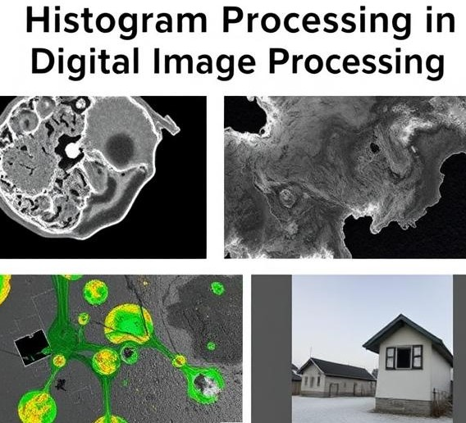
HISTOGRAM PROCESSING
BY NARESH (2023510042)

Slide 2
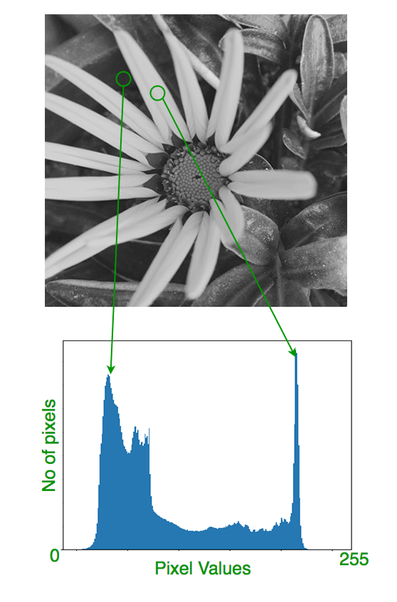
What is a Histogram?
A histogram is a graphical representation of the tonal distribution in a digital image. It plots the number of pixels for each tonal value, providing a global description of the image's appearance. The x-axis represents pixel intensity values, while the y-axis shows the frequency of each intensity. By analyzing the histogram, we can assess the image's contrast, brightness, and overall tonal balance.

Slide 3
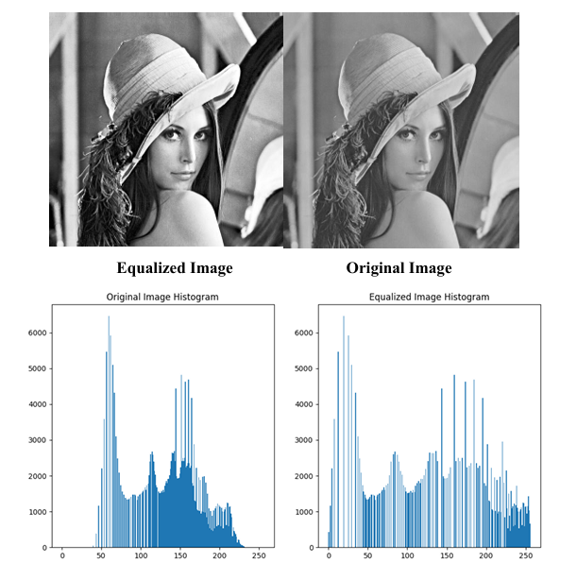
Histogram Equalization
One of the primary techniques in histogram processing is Histogram Equalization. This method enhances the contrast of an image by redistributing the pixel intensities across the entire available range. The goal is to achieve a uniform histogram, which can make details in dark or bright regions more visible.
The process involves calculating the cumulative distribution function (CDF) of the pixel intensities and mapping the original intensities to new values based on the CDF. This technique is particularly useful for improving the visibility of features in low-contrast images.

Slide 4
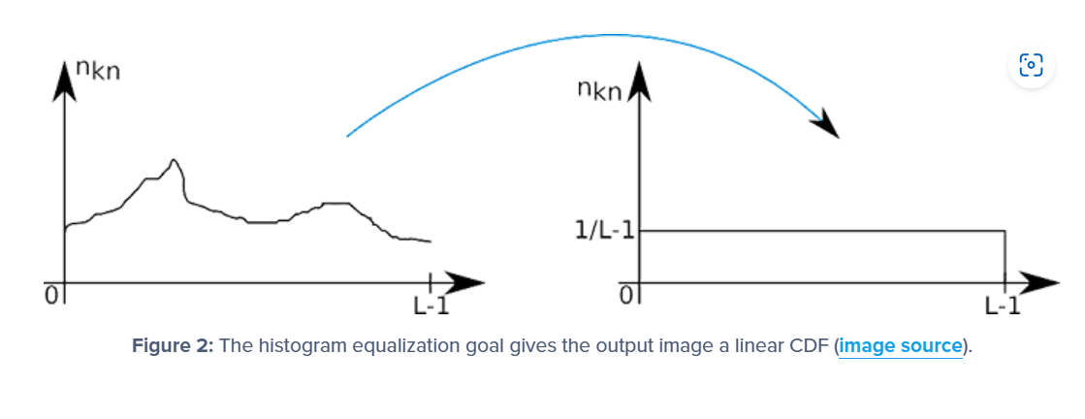
Cont.
The image illustrates the goal of histogram equalization using the cumulative distribution function (CDF). On the left, the graph shows the original CDF, which is uneven and represents the non-uniform distribution of pixel intensities in a low-contrast image. On the right, the graph shows the desired outcome after histogram equalization—a linear CDF indicating that the pixel intensities have been redistributed uniformly across the available range. This transformation enhances contrast and reveals more image details by spreading out the intensity values.

Slide 5
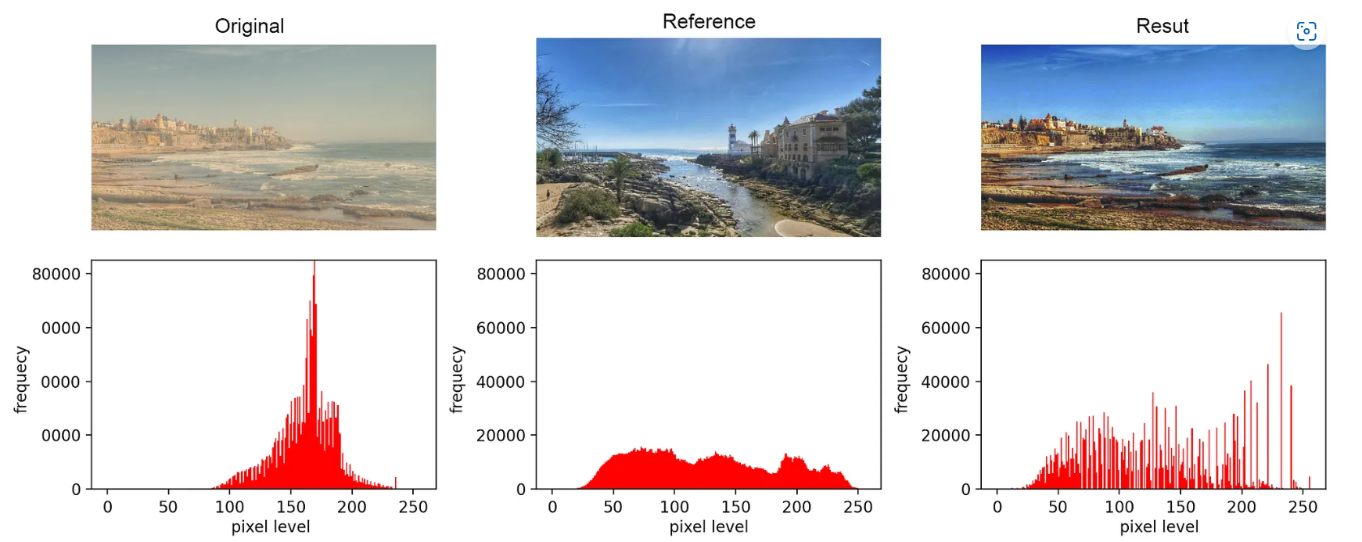
Histogram Matching
Histogram matching, also known as histogram specification, is a technique used in image processing to adjust the intensity distribution of one image so that it matches the histogram of another image, called the reference image. This method is especially useful when we want two images to have similar brightness and contrast characteristics. The process involves calculating the cumulative distribution function, or CDF, of both the input and reference images, and then mapping the pixel values of the input image to new values so that its histogram becomes similar to that of the reference.

Slide 6
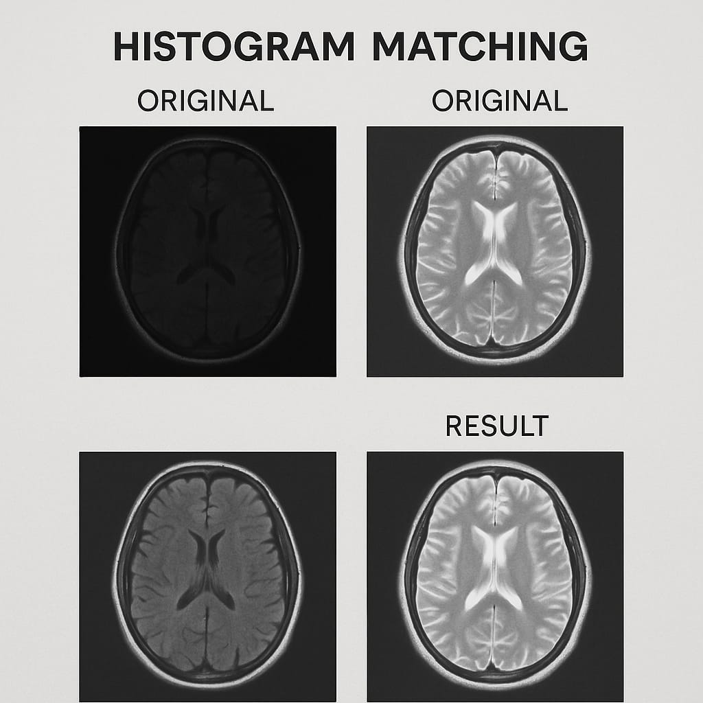
Histogram Matching cont.
Histogram matching is widely used in applications like medical imaging, remote sensing, and computer vision to ensure visual consistency across different images. For example, if two medical scans are taken under different lighting conditions, histogram matching can help standardize them for better comparison

Slide 7
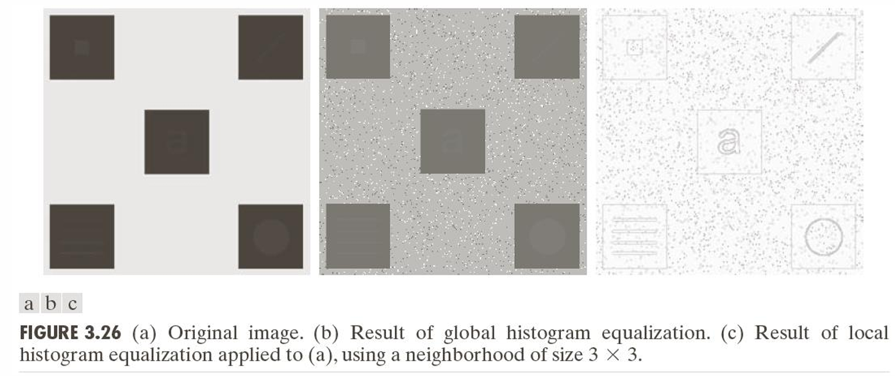
Local Histogram Processing
Unlike global techniques, Local Histogram Processing focuses on enhancing specific regions of an image. This is particularly useful when different areas of an image have varying lighting conditions or contrast levels.
Local Histogram Equalization divides the image into smaller regions and applies histogram equalization to each region independently. This approach enhances local contrast and can reveal details that might be obscured in the global histogram

Slide 8
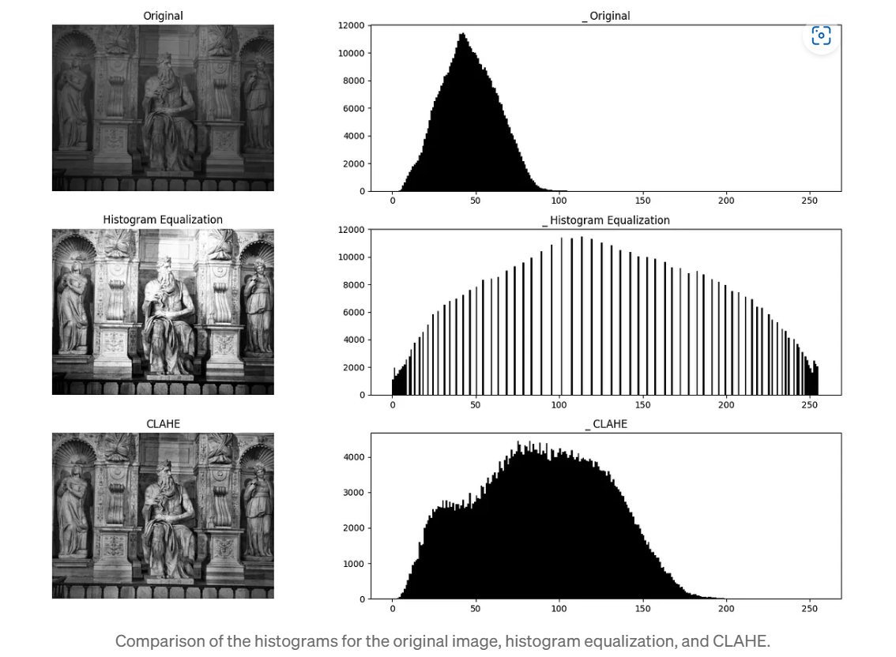
CLAHE (Contrast Limited Adaptive Histogram Equalization)
Another method is Adaptive Histogram Equalization, which adjusts the histogram based on local image characteristics, providing better results in images with varying illumination.
CLAHE (Contrast Limited Adaptive Histogram Equalization) is an advanced image enhancement technique that improves local contrast while avoiding the over-amplification of noise. It works by dividing the image into small tiles and applying histogram equalization to each tile individually. Unlike standard Adaptive Histogram Equalization, CLAHE limits the contrast enhancement by clipping the histogram at a specified threshold, preventing noise from becoming too prominent in low-contrast areas. This makes CLAHE especially effective in medical imaging and low-light photography, where detail enhancement is needed without introducing artifacts

Slide 9
ALGORITHM
1. Histogram Equalization (Global)
Improves contrast by spreading out intensity values.
Steps:
Compute Histogram of the image.
Normalize Histogram to get PDF (Probability Density Function).
Compute CDF (Cumulative Distribution Function) of the PDF.
Multiply CDF by (L−1), where L = number of intensity levels (usually 256).
Map original pixels using the new values from the CDF.
Construct Output Image with enhanced contrast.

Slide 10
CONT.
2. Histogram Matching (Histogram Specification)
Matches the histogram of one image to another (reference image).
Steps:
Compute Histogram & CDF of the input image.
Compute Histogram & CDF of the reference image.
Find Mapping between input and reference histograms via inverse CDF:
For each pixel intensity in the input, find a corresponding value in the reference so that the CDFs match.
Map the input pixel values using this transfer function.
Construct Output Image with histogram similar to the reference.

Slide 11
CONT.
3. Local Histogram Processing (Adaptive Histogram Equalization)
Improves contrast in local regions, useful for uneven lighting.
Steps:
Divide the image into small regions (tiles), e.g., 8×8 or 32×32 blocks.
Perform histogram equalization on each block independently.
Interpolate between adjacent tiles to smooth the boundaries.
Often done using bilinear interpolation.
Combine tiles to reconstruct the full enhanced image.

Slide 12
Applications of Histogram Processing
Histogram processing techniques are widely used in various fields:
Medical Imaging: Enhancing the contrast of X-rays or MRIs to reveal subtle details.
Satellite Imaging: Improving the visibility of features in remote sensing images.
Computer Vision: Preprocessing images for tasks like object detection and recognition.
Photography: Adjusting images to achieve desired aesthetic effects.
These techniques help in making images more interpretable and suitable for further analysis.

Slide 13
conclusion
In summary, histogram processing is a powerful tool in digital image processing, enabling us to enhance contrast, standardize image appearances, and improve local details. Techniques like histogram equalization, matching, and local processing are essential for effective image analysis and interpretation.
Done by Naresh V 2023510042 AI&DS
Thank you for watching!

Slide 14


